Slide 1
Department of Master of Computer Applications
Design Thinking
Natural Fencing for Farms.
Rajath Katti(1RV23MC079)
Niranjan Patil(1RV23MC063)
Priya Jyoti(1RV23MC074)
Pratheek Nayak(1RV23MC170)

Slide 2
Empathy Phase
Problem Statement
Farmers struggle with costly, high-maintenance fencing that fails to effectively manage livestock and wild animals. A low-maintenance natural fencing solution is needed to improve farm productivity and environmental balance.

Slide 3
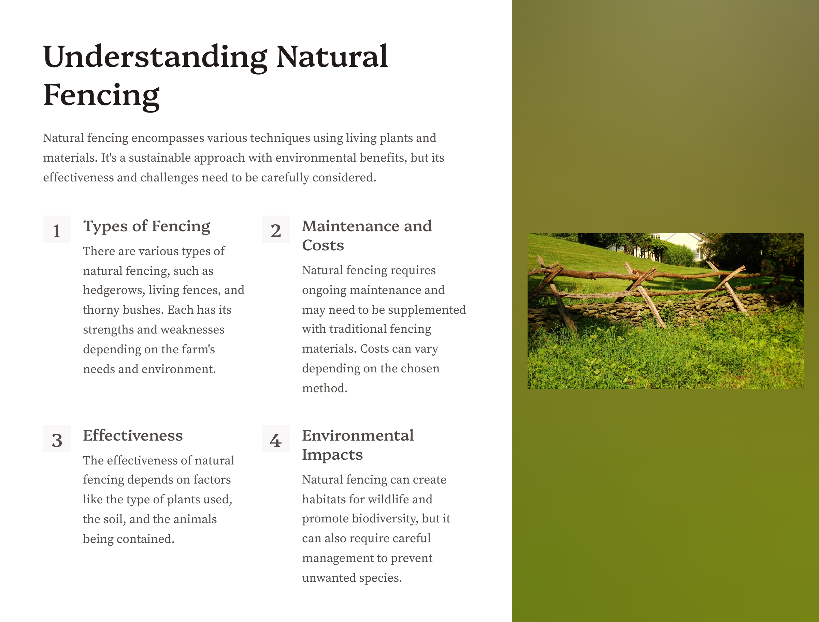

Slide 4
Background
Many farmers use fences to protect their land, protect their crops, and ensure privacy. But these fences can be expensive to put up and maintain, they often don't last long. Plus, traditional fences don't offer any extra benefits, like helping the farm's ecosystem or increasing the farm's income. The challenge is to create a natural fencing solution that is affordable, durable, and good for the environment while also adding value to the farm. and do the same job as regular fences, with added benefits like improving the farm's environment, lowering maintenance costs, and possibly boosting the farm's productivity and income.

Slide 5
Primary Research
Questionaries
What types of fencing do you currently use on your farm?
How much agricultural land do you have?
What challenges do you face with your current fencing solutions (e.g., maintenance, cost, effectiveness)?
Have you considered using natural fencing methods? If so, what was your experience like? If not, why not?
How much time and resources are you willing to invest in maintaining a natural fence?
What specific problems do you encounter with wildlife or livestock that fencing needs to address?
Are there any specific plants or materials you prefer or avoid for fencing?
How does fencing impact your overall farm productivity and operations?
How does the local climate and soil affect your fencing choices?
What are the most important factors for you when considering a new fencing option?

Slide 6
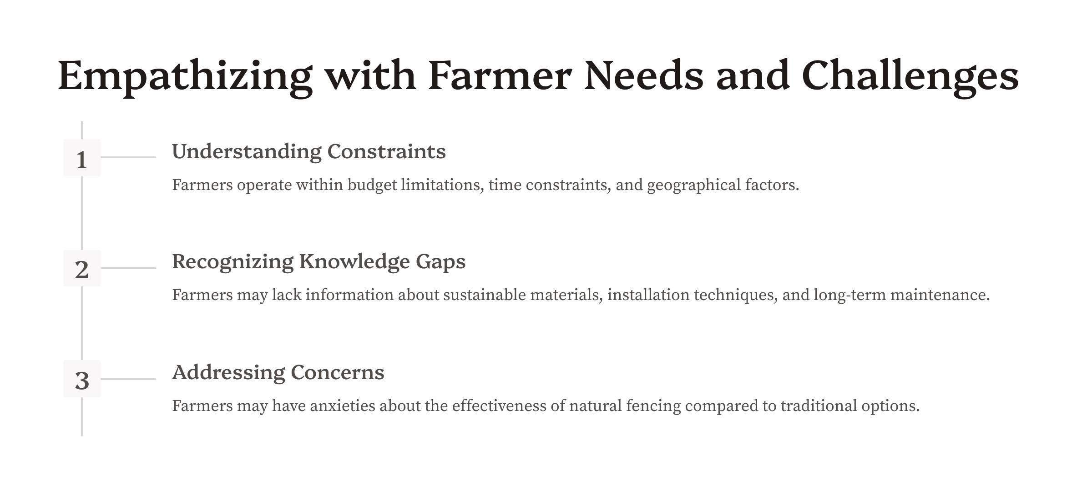

Slide 7
Interviews
Objective: To understand the challenges about natural fencing of farms in Karnataka through direct interviews.
Methodology:
Interview Mode: Conducted through phone calls.
Participants: farmers from different regions.
Data Collection: Calls were recorded to accurately gain information about fencing.

Slide 8
Key Information Collected:
High Maintenance Costs: Farmers expressed concerns about the ongoing maintenance required for current fencing, including repairs and replacements.
Local Materials Preference: Farmers prefer using locally sourced plants and materials for natural fencing, aligning with their sustainability goals
Wildlife and Animal Control: Existing fences often fail to keep out wildlife , leading to crop damage.

Slide 9
Personification and Story telling
In the village of Kuthali in Belgaum district, Veerendra runs a two acre farm where he grows sugarcane, Tobacco, and vegetables. He has a lot of trouble with his current fencing. The current wire fences often break, letting wild animals like boars , wolves and fox into his fields, which damages his crops. Fixing the fence is expensive and takes up a lot of his time. Veerendra has heard about natural fencing, but he’s unsure if it will work as well as his metal fence. He’s also worried about the impact of metal fences on the environment and hopes to find a solution with least cost that’s better for his farm and the land.

Slide 10
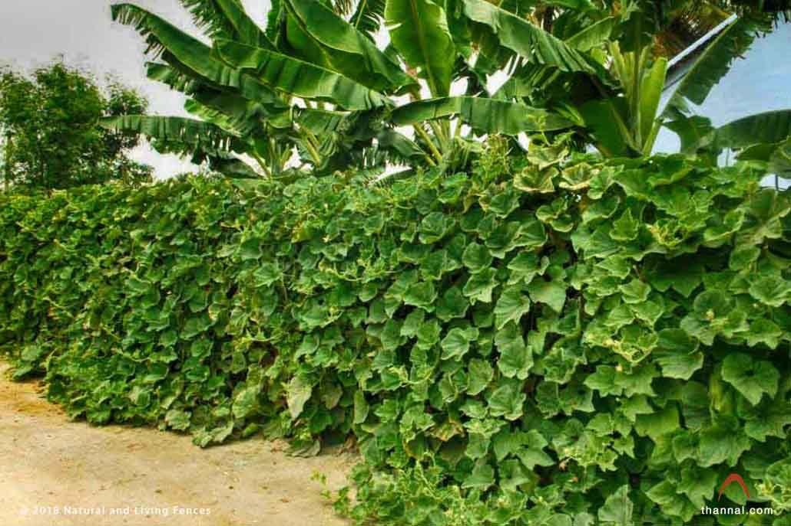
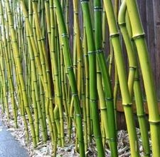
Images

Slide 11
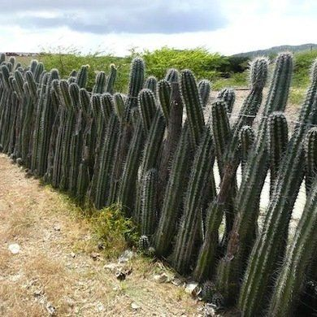
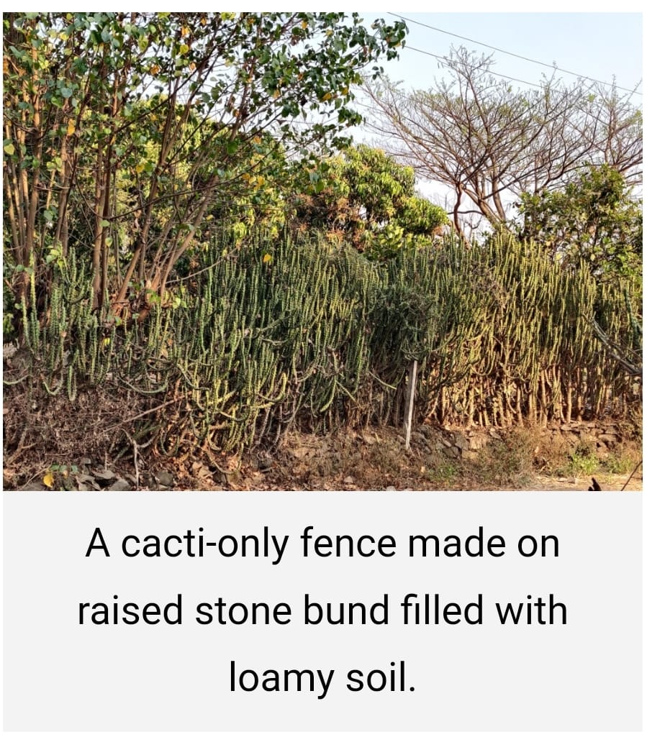

Slide 12
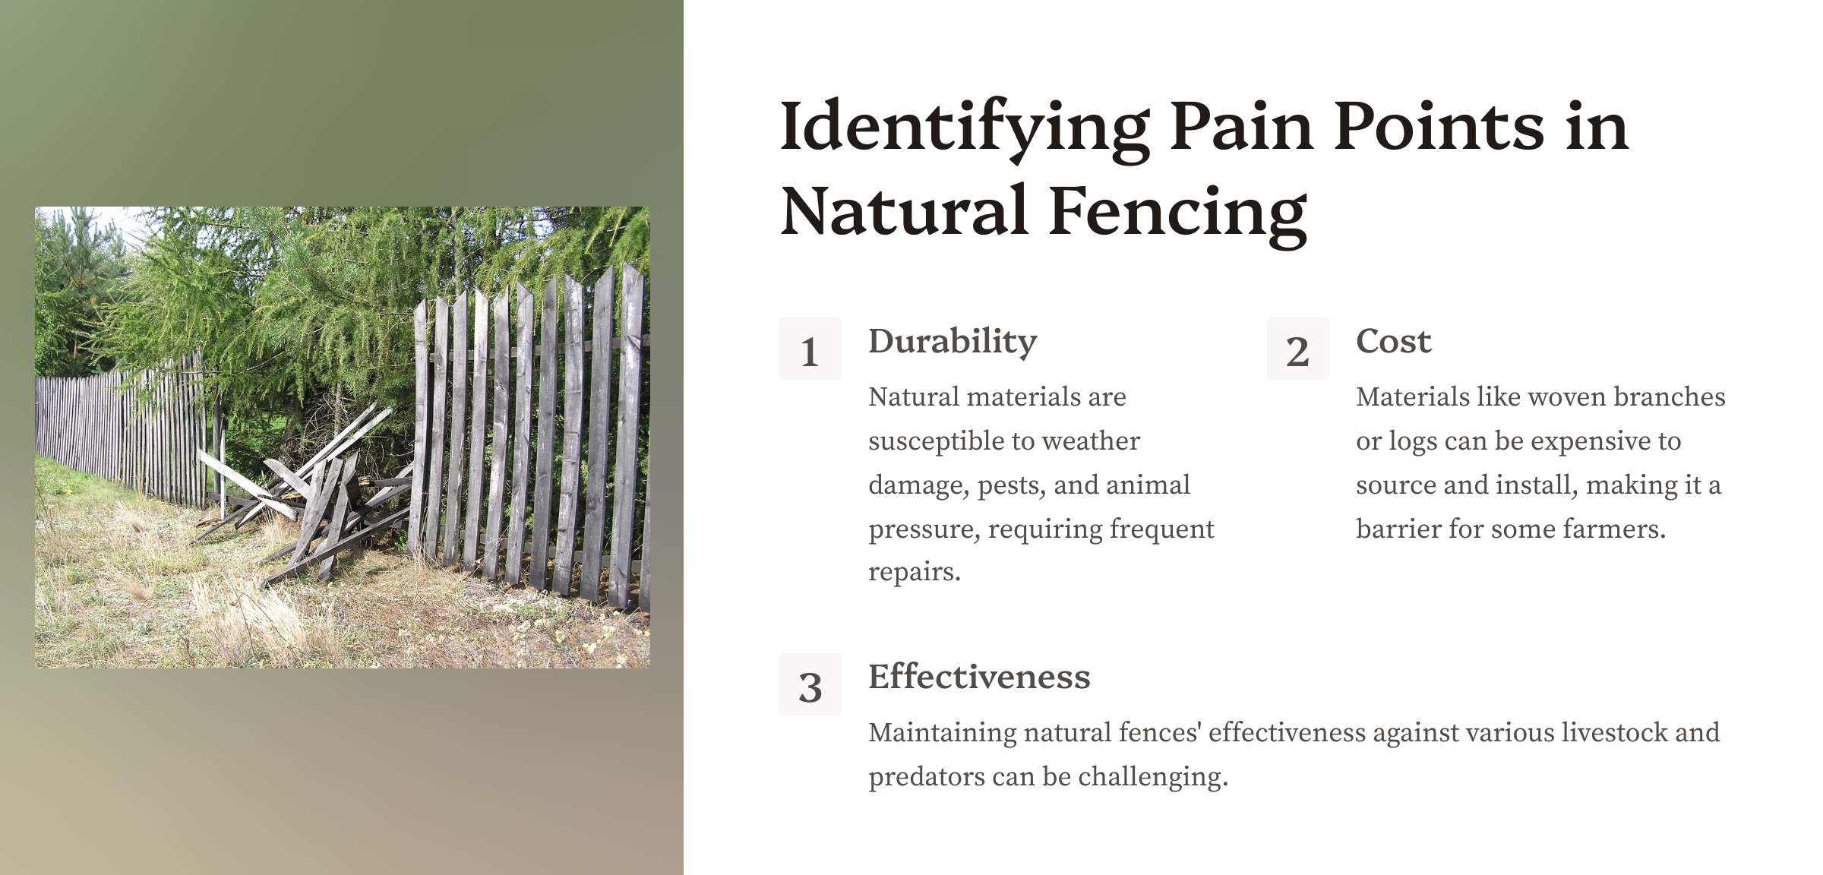

Slide 13
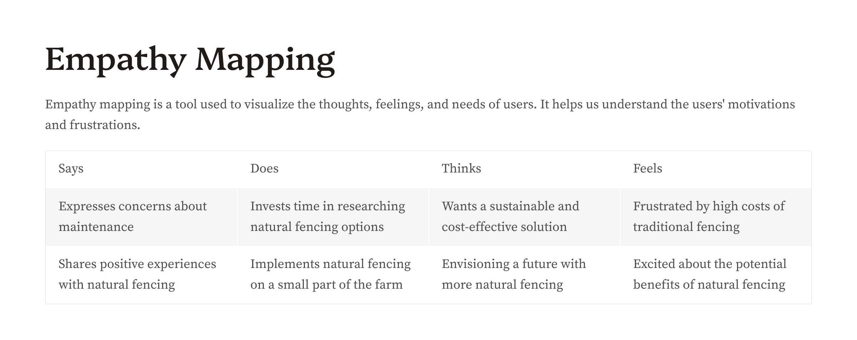

Slide 14
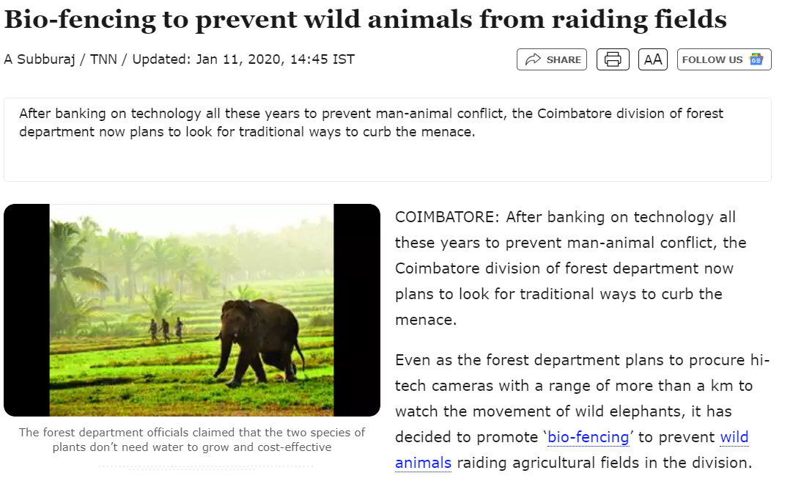

Slide 15
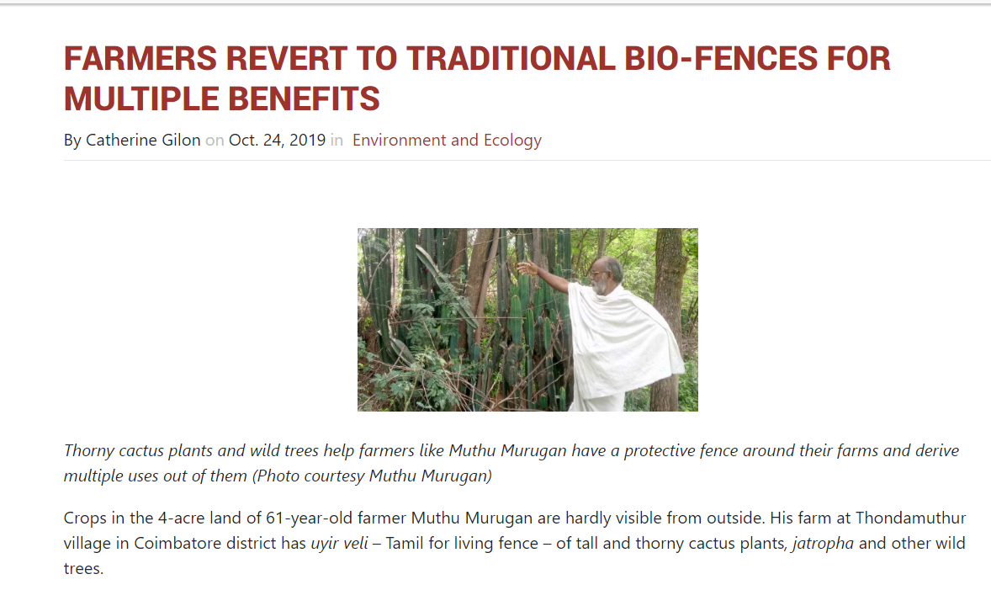

Slide 16
Natural Fencing for Farms – Define Phase
A cost-effective and eco-friendly solution for farmers

Slide 17
Problem Overview
The Problem – Lack of Affordable Farm Fencing
Many small-scale and low-income farmers cannot afford traditional fencing materials like barbed wire, metal, or wood.
Unfenced farms are vulnerable to:
Grazing animals (e.g., cattle, goats) that destroy crops.
Trespassers who can cause damage or theft.
Loss of crops due to lack of protection.
Traditional fencing solutions are expensive, labor-intensive, and often require regular maintenance, which adds to the cost.
NEED: A natural, low-cost, eco-friendly alternative that provides protection while being easy to maintain.

Slide 18
User Persona
Persona: A small-scale farmer named Ram, with a 2-acre farm, primarily growing vegetables for local markets.
Challenges:
Ram’s farm is regularly damaged by stray animals.
He cannot afford barbed wire fencing or regular maintenance for traditional fences.
Ram needs a solution that is affordable, sustainable, and requires minimal upkeep
Goals:
To protect his crops with a cost-effective solution.
To implement fencing using materials that are locally available, like bamboo or thorny plants.

Slide 19
Goal of the Define Phase
Objective: The Define phase aims to create a clear, actionable problem statement by synthesizing information gathered in the Empathize phase.
Why it matters: Clearly defining the problem helps to avoid irrelevant solutions and ensures that the team's efforts are focused on solving the core issue.
Focus:
Understanding farmers' needs and challenges.
Identifying the environmental and resource constraints they face.

Slide 20
Problem Statement
Statement: “Farmers with limited resources need a cost-effective, eco-friendly fencing solution to protect their crops from animals and trespassers because traditional fencing is too expensive and difficult to maintain.”
Core Needs:
Affordable materials that are easy to implement.
Use of locally available plants like bamboo, cactus, and thorny plants for natural fencing.
A solution that can be scaled to different farm sizes.

Slide 21
Why Define Stage is Important
Ensures the design problem is clearly identified and aligned with farmers' real needs.
Benefits:
Avoids solutions that don’t target the actual issue.
Helps focus the team on sustainable, natural resources that fit the farmers’ context.
Impact of a Poorly Defined Problem:
Misaligned solutions that are impractical or costly.
Resources wasted on ideas that fail to solve the core problem.
Clearly defining the problem sets the stage for a successful ideation phase.

Slide 22
Exploring Natural Fencing Solutions
Examples of Natural Fencing:
Bamboo: Grows quickly, provides a dense barrier, and is sustainable.
Cactus: Naturally thorny, drought-resistant, and effective in arid regions.
Thorny plants (e.g., Bougainvillea): Provides an impenetrable barrier for animals.
Benefits:
Low cost, since many of these plants are locally available.
Sustainable: They can regenerate, reducing the need for ongoing investments.
Environmentally friendly, reducing the use of non-biodegradable materials like plastic or metal.
Challenges:
Initial planting time before the fencing is effective.
Requires knowledge of which plants are best suited to different climates and soil types.

Slide 23
Moving to the Ideation Phase
What comes next:
Brainstorming creative solutions based on the defined problem.
Generate ideas for different types of natural fences using locally sourced plants.
Key Focus:
Experimenting with combinations of natural materials like bamboo and cacti.
Seeking feedback from farmers to validate the solutions.
Testing the effectiveness of the proposed solutions on farms.

Slide 24
Natural Fencing for Farms – Ideation Phase
Generating creative solutions for affordable farm protection

Slide 25

What is the Ideation Phase?
The Ideation phase is where creative ideas are generated to solve the problem defined in the previous phase.
The goal is to come up with as many potential solutions as possible, without immediately judging their feasibility.
This phase encourages out-of-the-box thinking and collaboration.

Slide 26
Goals of the Ideation Phase
Generate a wide range of ideas: Come up with a variety of solutions, both conventional and unconventional.
Focus on user needs: Ensure the ideas focus on the core problem (affordable natural fencing) and farmer needs.
Encourage collaboration: Involve stakeholders (farmers, agricultural experts) to get diverse perspectives.
Embrace creativity: Allow free thinking and innovation without being limited by practical constraints at this stage.

Slide 27

Brainstorming Techniques
Mind Mapping: Visually connecting ideas around the
central problem of "Natural Fencing."
SCAMPER: (Substitute, Combine, Adapt, Modify, Put
to another use, Eliminate, Reverse) technique to
trigger innovative ideas.
Brainwriting: Each participant writes down 3 ideas
and passes them to others for further building.

Slide 28
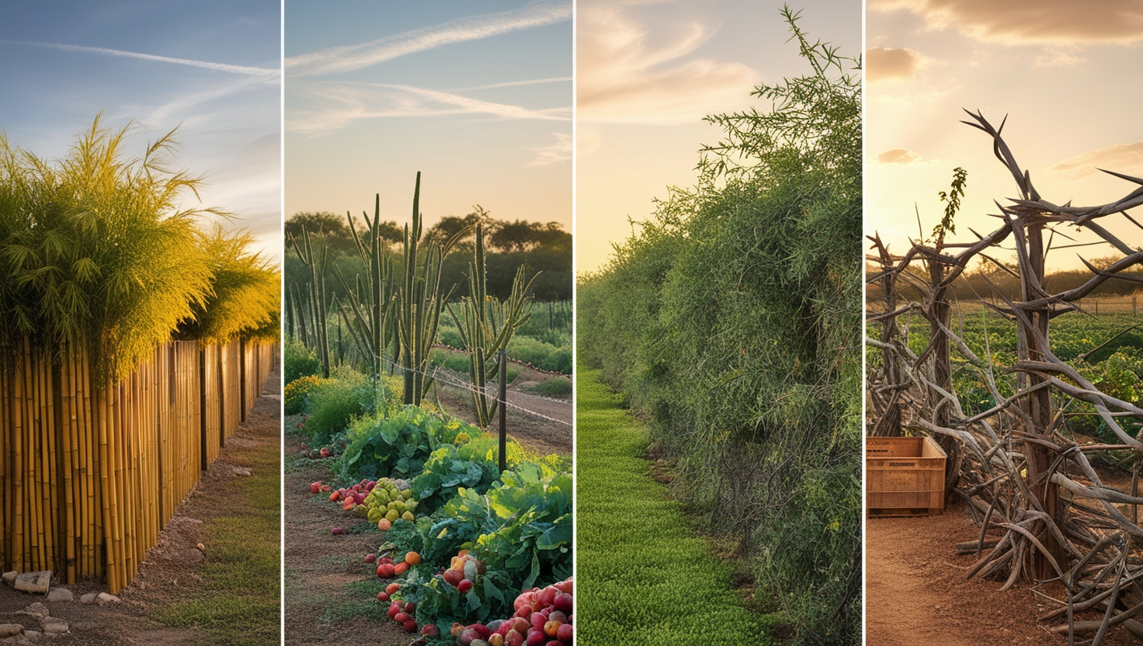
Idea Generation – Natural Fencing Options
Bamboo Fences:
Fast-growing, renewable, and forms a thick barrier.
Cactus Fences:
Thorny, drought-resistant, and naturally deters animals.
Thorny Bushes and Shrubs:
Native plants that can form a dense, impenetrable hedge.
Combination Fences:
A mix of bamboo and cactus to increase effectiveness.
Innovative Options:
Use of bio-fencing with plants like Agave or Euphorbia.

Slide 29
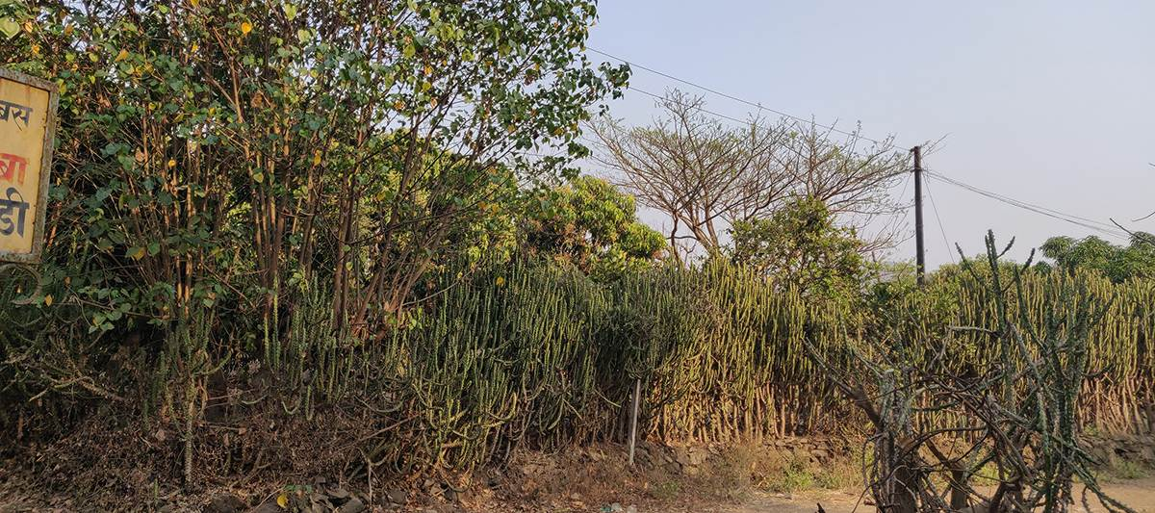
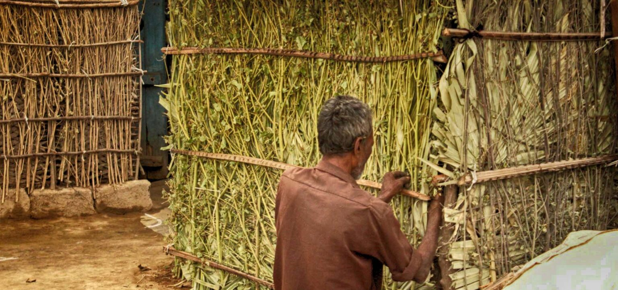
Natural Fencing Options
The image shows a natural fence made of cacti, providing a dense, spiky barrier for farm protection while blending with the surrounding vegetation.
The image shows a man building a natural farm fence using sticks and branches, creating an eco-friendly barrier for crop protection.

Slide 30
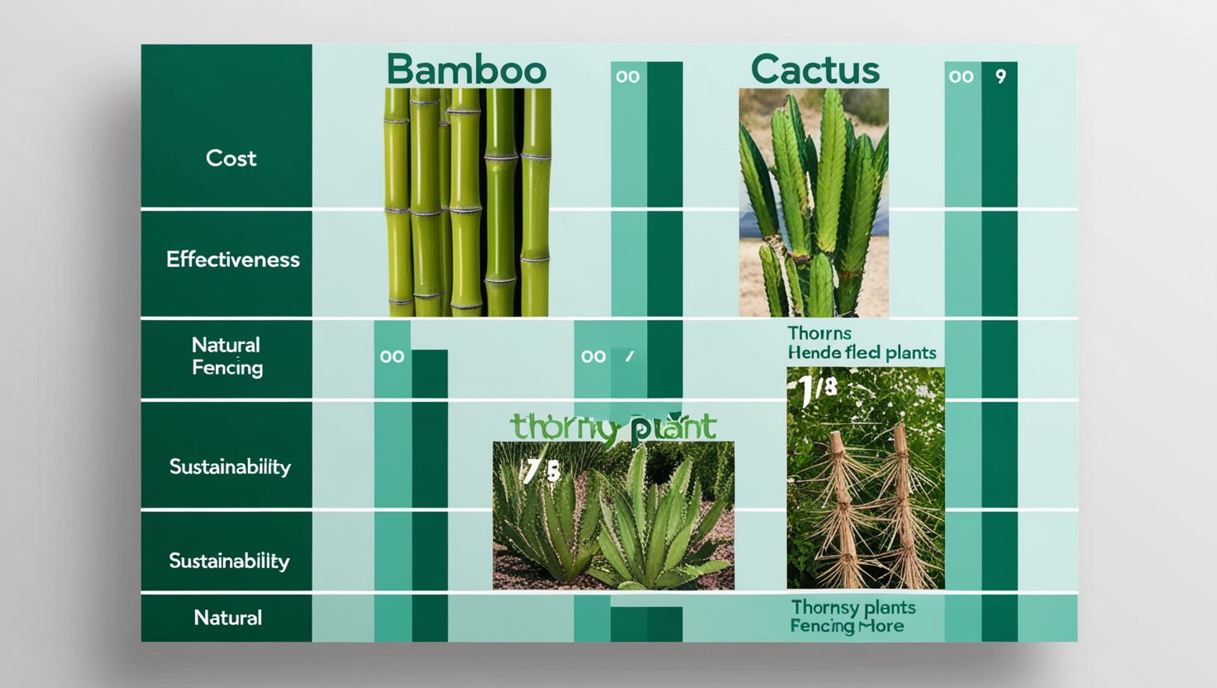
Evaluating Ideas
After brainstorming, we evaluate ideas
based on:
Cost: Is it affordable for small-scale
farmers?
Effectiveness: How well does the
fence protect the farm?
Sustainability: Is it eco-friendly and
low-maintenance?
Availability: Are the materials locally available?
Begin to shortlist ideas that meet these criteria.

Slide 31
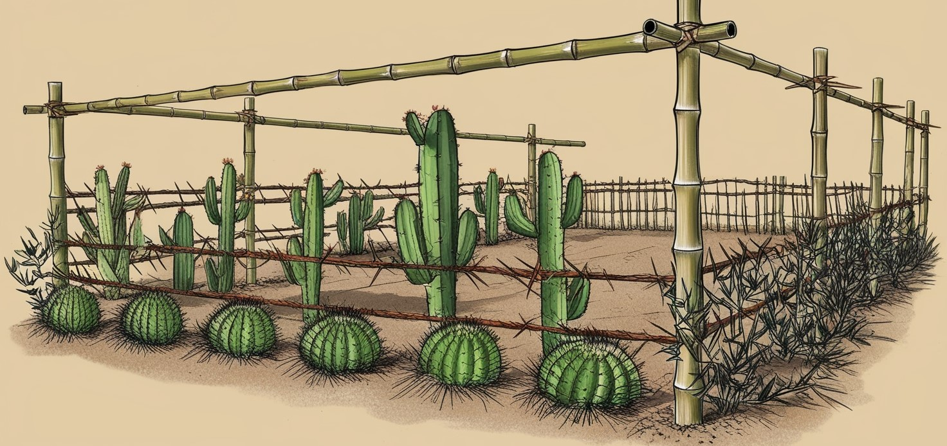
Refining and Combining Ideas
Combine the best ideas: For example, using bamboo as the main fence structure with cactus plants for added protection.
Refine individual ideas: Improve feasibility by tweaking some ideas (e.g., making bamboo more
pest-resistant by treatment).
Prototype potential solutions:
Start imagining what a prototype
of the natural fence might look
like and how it can be tested on
farms.

Slide 32
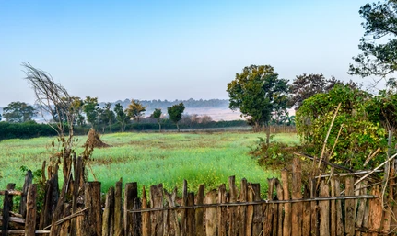
Prototype:
Wood fences
• Traditionally used type of fencing.
• Very cheap and easy to set up but not durable for a longer period of time.
• Can be used with simple wire during setup.

Slide 33
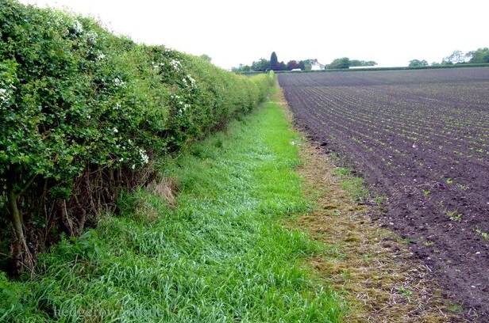
Hedgerows:
A dense row of shrubs and small trees planted along the perimeter of farmland.
Benefits:Deters animals naturally by creating a thick, prickly barrier.
Provides shelter for birds and other wildlife, enhancing biodiversity.
Can reduce soil erosion and improve land health.

Slide 34
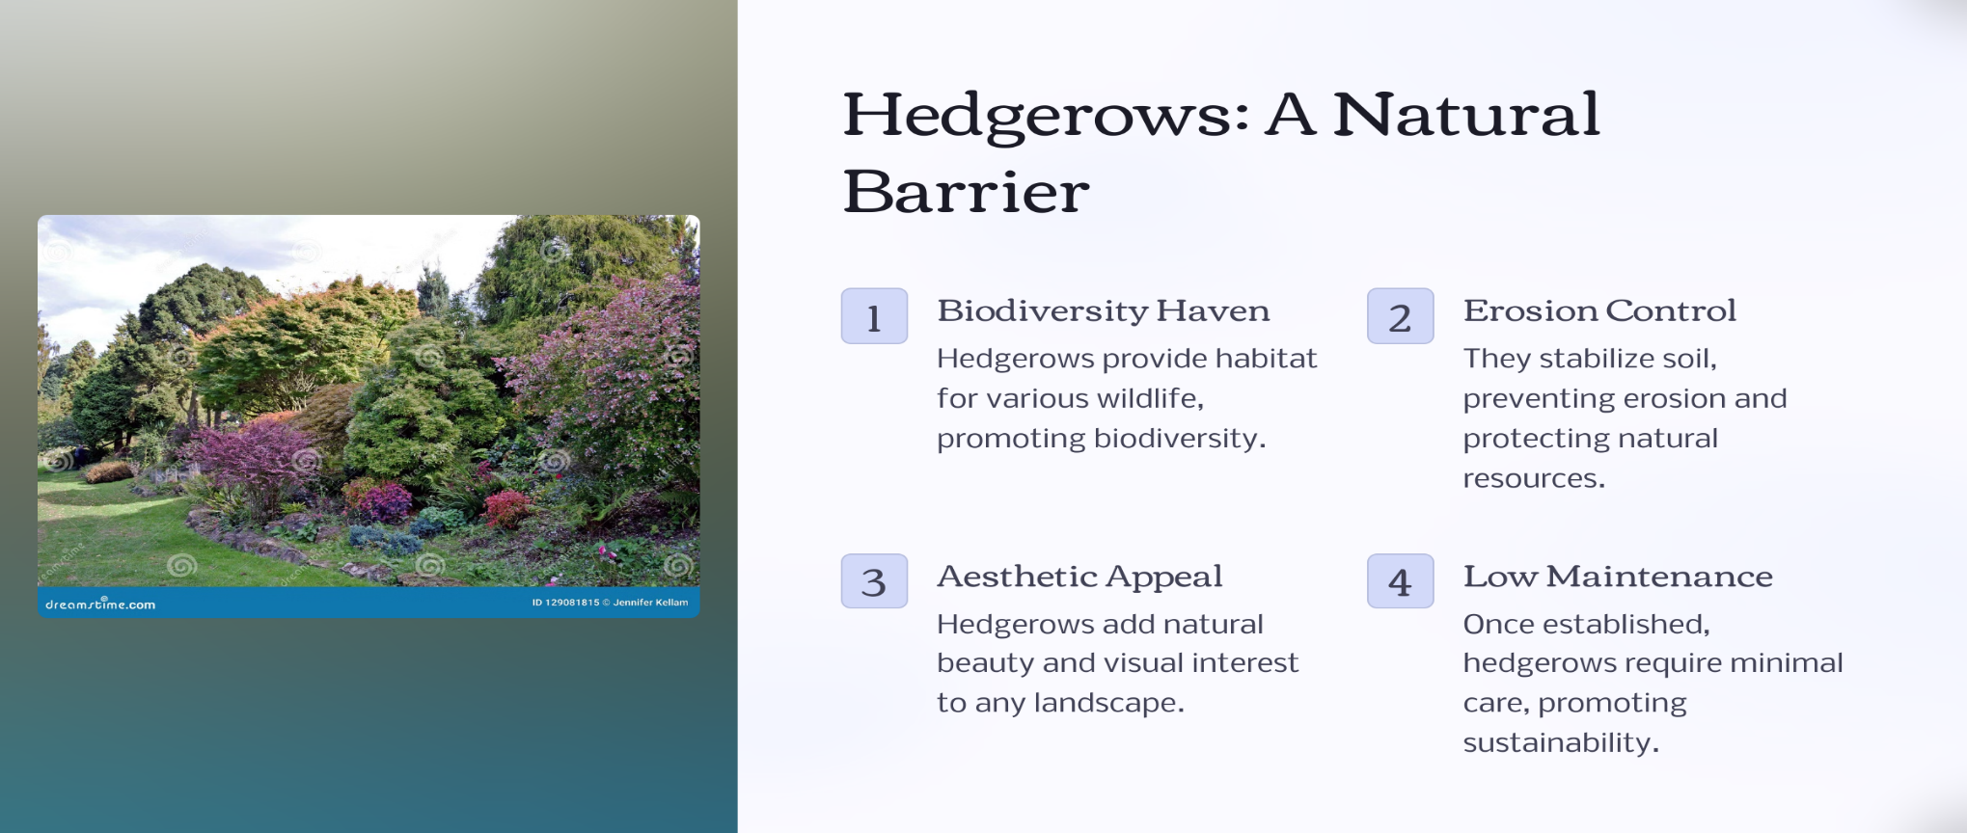

Slide 35
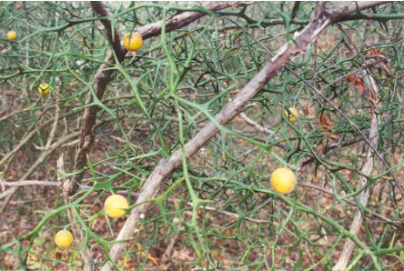
Lime Thorn Bushes
Benefits:
Natural Deterrent: The sharp thorns on lemon and lime bushes act as a strong deterrent to animals that might try to enter farmland.
Economic Benefit: Farmers can harvest lemons or limes for personal use or to sell at markets

Slide 36
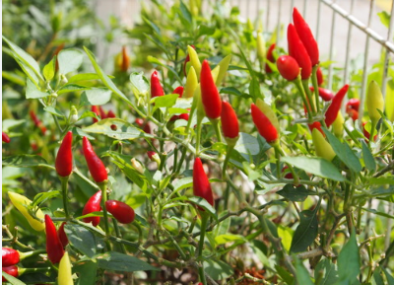
Chili Peppers
Benefits:
Planting chili peppers around farm boundaries can deter elephants from entering fields without harming them.
Additional Income for Farmers: Chili peppers are a valuable cash crop in many regions.

Slide 37
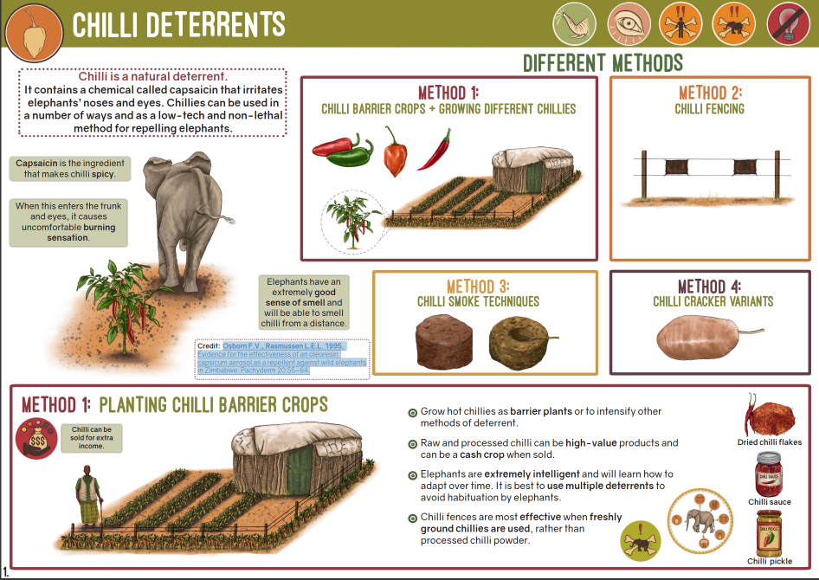

Slide 38
Potential Natural Fencing Solutions
Lemongrass, agave or rambans, certain species of chilly and some other plant species have been identified to be grown for fencing.
Leopards and bears, along with elephants and wild boars are a major threat to human life, livestock and crops.
Traditional methods like solar-powered wire fencings, walls and pits in the woods prevent the entry of elephants, wild boars, tigers, leopards and others in residential areas.

Slide 39
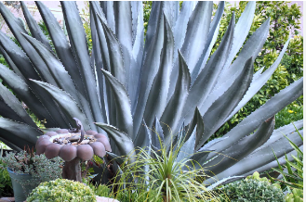
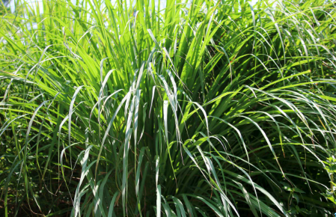

Slide 40
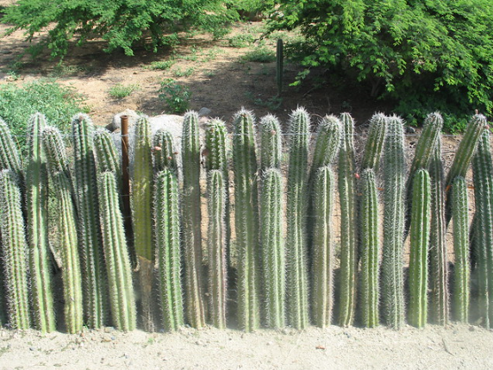
Cacti or Thorny Plants:
Cacti or Thorny Plants:
create a natural defense against larger animals like wild boar or deer.
Benefits:
Drought-Resistant: Cacti and many thorny plants requires minimal water and care
Root Stability: The deep root systems of cacti and thorny shrubs help stabilize soil

Slide 41
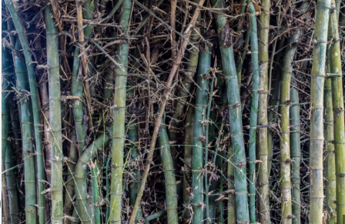
Bamboo
Grows Quickly: Bamboo grows fast and doesn’t need replanting.
Good for the Environment: It absorbs CO2 and produces more oxygen.
Strong Barrier: Works well as a natural fence and helps prevent erosion.
5.Boosts Income: Can be sold for extra money and improves local wildlife habitat.

Slide 42
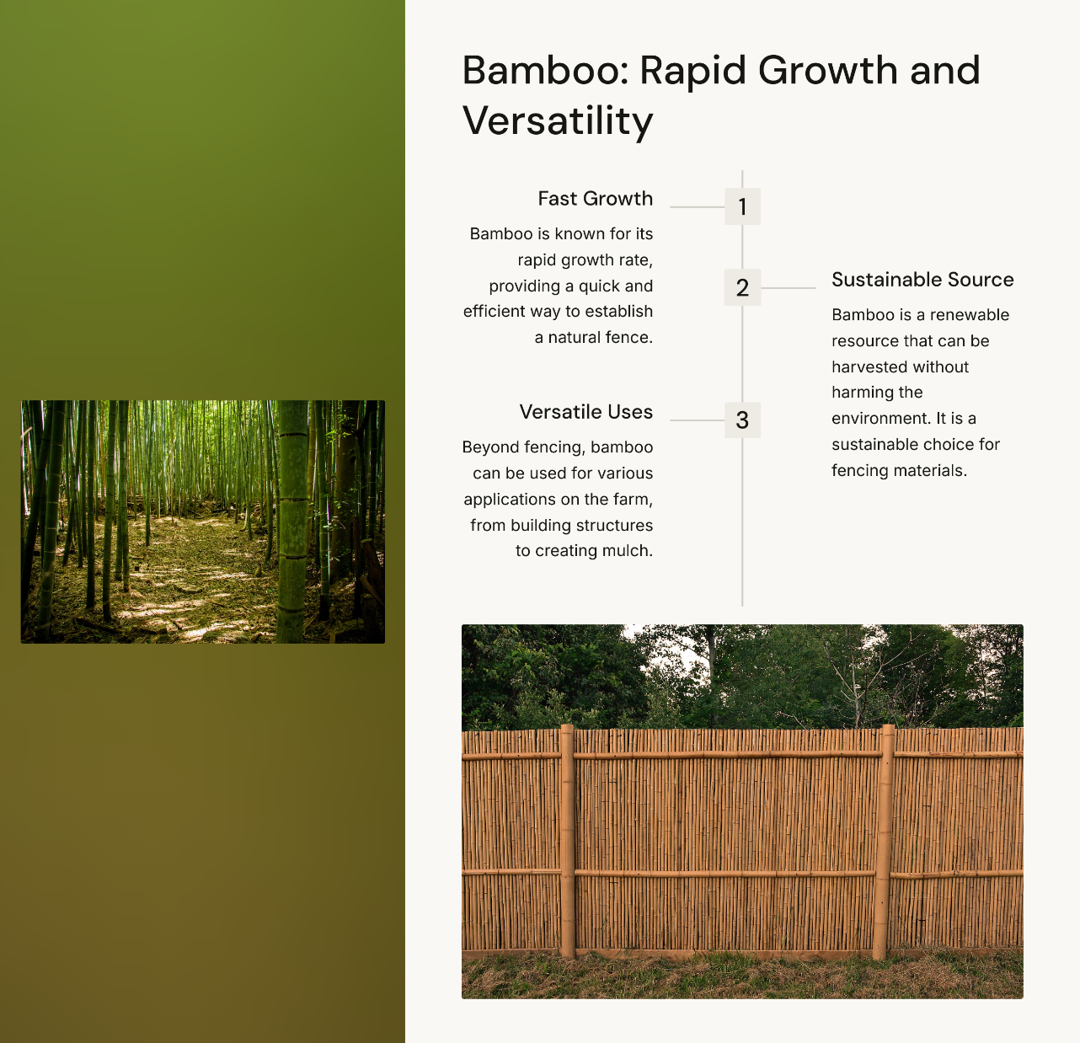

Slide 43
Test Phase
Wood Fencing:
Test Setup: Erect wooden fences around a designated area of farmland.
Testing Criteria: Monitor for any animal entry points or damage over time. Assess the durability of the wood, maintenance needs, and how well it prevents trespassing.
Measure: Success rate in preventing entry of animals like deer, cattle, or smaller animals.
Chilli Pepper:
Test Setup: Create barriers using chilli pepper plants or sprinkle chilli powder around the field perimeter.
Testing Criteria: Assess how the presence of capsaicin deters animals. Check if animals avoid the area due to irritation.
Measure: Reduction in animal encounters and the impact on soil or plant life nearby.

Slide 44
Hedgerows:
Test Setup: Plant thick rows of shrubs or trees along the farm perimeter.
Testing Criteria: Observe if the density of the hedgerow effectively deters animals from crossing. Evaluate growth rates and coverage over time.
Measure: Animal entry attempts, gaps in hedgerow growth, and long-term viability.
Lime Thorn Bushes:
Test Setup: Plant lime thorn bushes in a boundary line around the field.
Testing Criteria: Monitor for animal trespassing, particularly through gaps or weak spots. Check if the thorny nature discourages entry.
Measure: Effectiveness in blocking animals, growth patterns, and required care.

Slide 45
Cactus and Thorny Plants:
Test Setup: Plant cactus and other thorny species around the farm.
Testing Criteria: Monitor if the spiny, thorny nature of these plants physically prevents animals from crossing the barrier.
Measure: Incidence of animal injuries or avoidance due to the sharpness, and plant resilience over time.
Bamboo:
Test Setup: Plant bamboo along the farm's perimeter to create a dense natural wall.
Testing Criteria: Monitor how well the fast-growing bamboo creates a physical barrier. Observe how animals interact with the bamboo.
Measure: Speed of bamboo growth, its effectiveness in blocking animals, and overall maintenance required.

